Slide 1
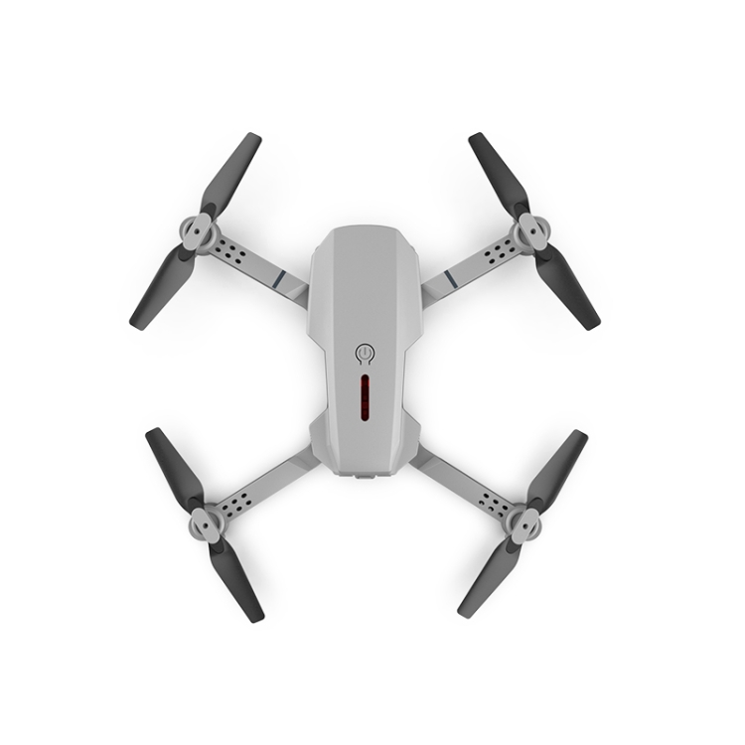
Quadcopter flight controller
Optimal control and dynamic programming principle

Slide 2
Project
The objective of the controller is to stabilize the drone's position in the air while minimizing the energy consumption of the drone's motors.
Designing a flight controller for a quadcopter drone involves a complex optimization problem that can be solved using the techniques of control theory.
One approach to this problem is to use the Linear Quadratic Regulator (LQR) method.
The goal is to design a feedback controller that minimizes a cost function that reflects both the performance of the system and the control effort required to achieve that performance

Slide 3
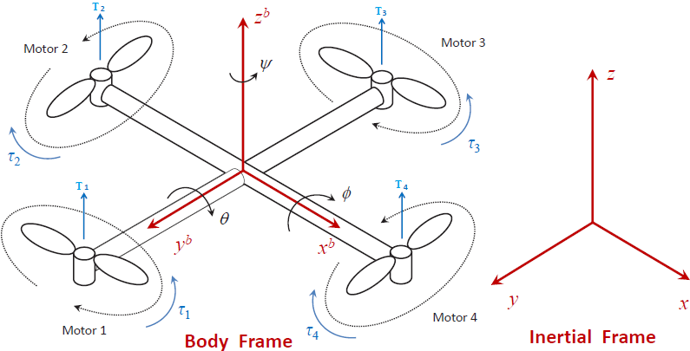
Solution

Slide 4
Linearized dynamics of the quadcopter drone
x = Ax + Bu
y = Cx + Du
Where `x` is the state vector, `u` is the control input, and `y` is the output vector.
The matrices `A`, `B`, `C`, and `D` are constant matrices that describe the linearized dynamics of the system.

Slide 5
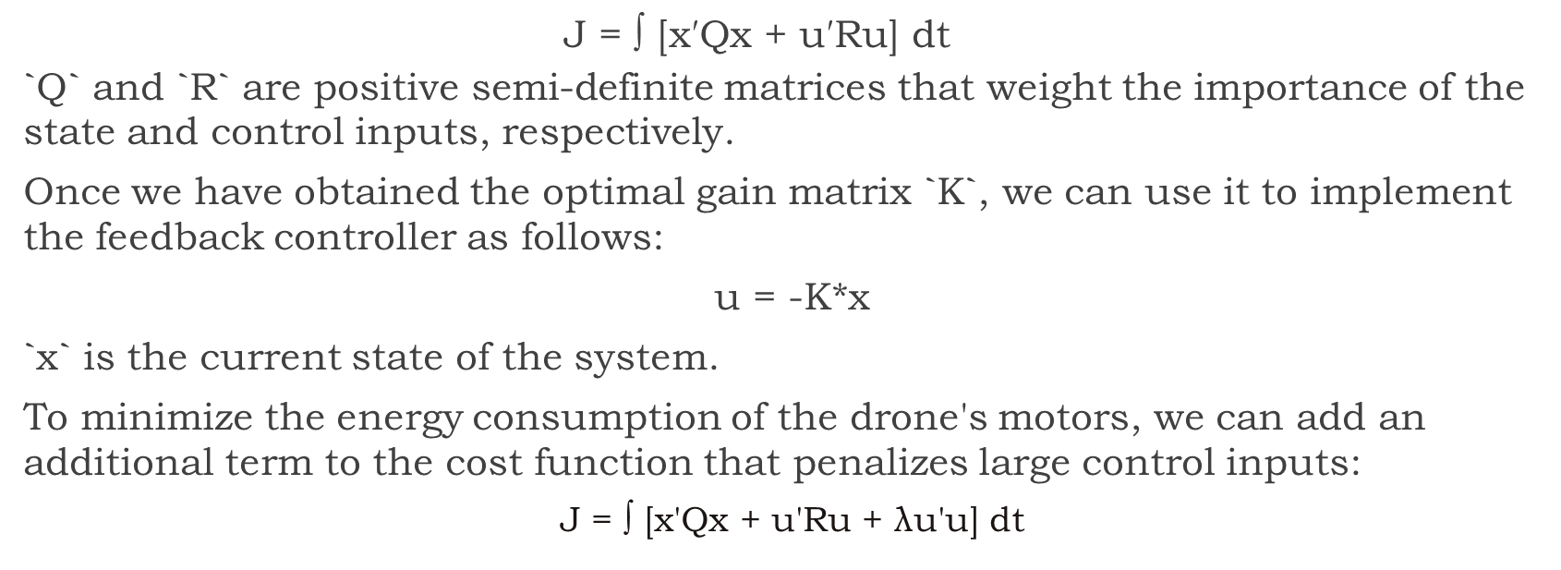
Cost Function
$$\text{J}\text{ = ∫ [}\text{x}\text{′}\text{Qx}\text{ + }\text{u}\text{′}\text{Ru}\text{] }\text{dt}$$
`Q` and `R` are positive semi-definite matrices that weight the importance of the state and control inputs, respectively.
Once we have obtained the optimal gain matrix `K`, we can use it to implement the feedback controller as follows:
u = -K*x
`x` is the current state of the system.
To minimize the energy consumption of the drone's motors, we can add an additional term to the cost function that penalizes large control inputs:
J = ∫ [x'Qx + u'Ru + λu'u] dt

Slide 6
MATLAB
% Quadcopter control with LQR
% Define physical parameters
m = 1.0; % mass of the quadcopter (kg)
I = 0.1; % moment of inertia about the vertical axis (kg*m^2)
g = 9.81; % gravitational acceleration (m/s^2)
% Define the system matrices
A = [0 1 0 0; 0 0 0 0; 0 0 0 1; 0 0 0 0];
B = [0 0; 1/m 0; 0 0; 0 1/I];
C = [1 0 0 0; 0 1 0 0];
D = [0 0; 0 0];
% Define the weighting matrices for LQR
Q = diag([10 1 10 1]); % state weights
R = 0.1*eye(2); % control weights
% Compute the optimal feedback gain with LQR
[K, S, ~] = lqr(A, B, Q, R);
% Define the closed-loop system with the optimal gain
Ac = (A - B*K);
Bc = B;
Cc = C;
Dc = D;

Slide 7
Simulation and results
% Define the initial condition and simulation time
x0 = [0; 0; 0; 0];
tf = 10;
% Simulate the closed-loop system with a step input
t = linspace(0, tf, 1000);
r = ones(size(t));
r = [r' 0*r']'; % reshape r to be a matrix with 2 columns
[y, t, x] = lsim(ss(Ac, Bc, Cc, Dc), r, t, x0);
% Plot the results
figure();
plot(t, y(:,1), 'b-', 'LineWidth', 2);
hold on;
plot(t, y(:,2), 'r-', 'LineWidth', 2);
grid on;
legend('Position (m)', 'Angle (rad)');
xlabel('Time (s)');
ylabel('State');
title('Quadcopter Control with LQR’);
% Add titles to individual lines
title('Quadcopter Position and Angle');

Slide 8
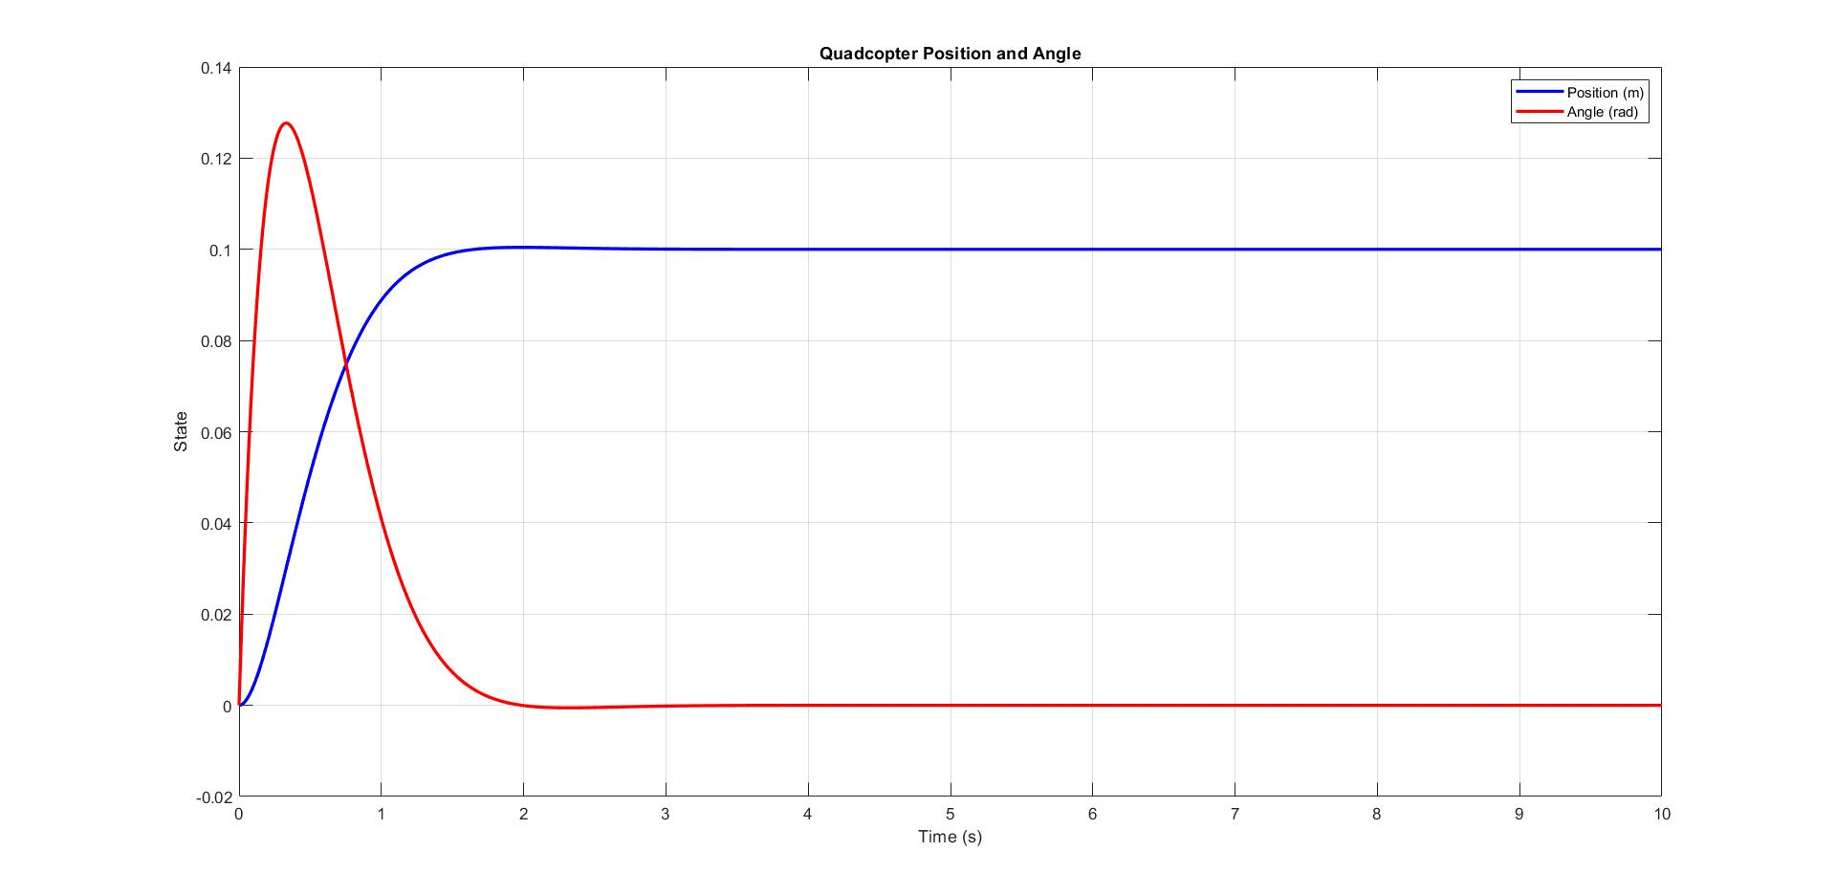
Position response
Angle response

Slide 9
QUESTIONS?

